Slide 1


Department of Computer Science and Engineering
CS19811 – Project Phase-II
EVOLVED RETAIL: HARNESSING MARKERLESS AR TO ENHANCE VIRTUAL SHOPPING EXPERIENCES
DARSHAN KRISHNA 210701046
MOKESHWARAN210701516
Dr.S. Vinodkumar
Professor

Slide 2
Abstract
The proliferation of deep fake technology has raised significant concerns regarding the authenticity of visual content on the internet. In this paper, we propose a novel approach for detecting deep fake images using machine learning techniques. Our method leverages convolutional neural networks (CNNs) to extract high-level features from images and employs advanced classification algorithms to distinguish between authentic and manipulated content. We discuss the importance of dataset selection and augmentation techniques in training robust models capable of accurately identifying deep fake images. Additionally, we explore the effectiveness of different architectural configurations and preprocessing methods in improving detection performance. Experimental results demonstrate the efficacy of our approach in accurately detecting deep fake images across various datasets and manipulation techniques. Finally, we discuss potential applications and future directions for enhancing deep fake detection systems in real-world scenarios.

Slide 3
Existing System
The existing systems in deep fake detection for images using machine learning encompass a range of methodologies and techniques aimed at identifying and mitigating the proliferation of manipulated visuals. Leveraging convolutional neural network (CNN) architectures, researchers have developed sophisticated models capable of discerning subtle discrepancies between authentic and fake images. These models often rely on extensive datasets comprising both real and synthetic images to train and validate their performance. Adversarial learning techniques, including generative adversarial networks (GANs), have also gained prominence, enabling the detection of increasingly sophisticated deep fake manipulations through adversarial training methods. Ensemble learning approaches further enhance detection accuracy by combining predictions from multiple models trained on diverse datasets and feature representations.

Slide 4
Proposed System
In response to the escalating threat posed by deep fake technology, we propose a comprehensive system for detecting deep fake images using advanced machine learning techniques. Our proposed system, named "Deep Fake Guard," is designed to address the challenges associated with identifying manipulated visual content and to provide robust protection against the spread of synthetic media manipulation. At the core of Deep Fake Guard lies a meticulously curated dataset comprising a diverse range of images, including both authentic and deep fake examples. This dataset serves as the foundation for training and evaluating our deep learning models, ensuring their effectiveness and generalization across different manipulation techniques and scenarios.

Slide 5
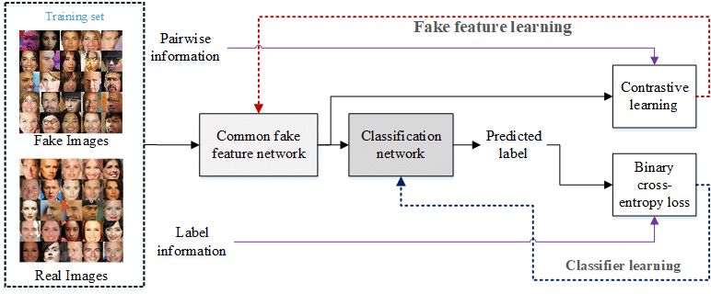
System Architecture

Slide 6
Functional Description Of Module
This project involves developing a machine learning model to detect deep fake images by analyzing visual and statistical features. The process begins with data collection, comprising a balanced dataset of genuine and deep fake images. Next, image preprocessing techniques such as resizing, normalization, and augmentation are applied to enhance model robustness. Feature extraction methods, including convolutional neural networks (CNNs), are employed to capture intricate patterns indicative of deep fakes. The core of the project is the training phase, where the model learns to distinguish between real and fake images. Finally, model evaluation and refinement are conducted using accuracy, precision, recall, and F1-score metrics to ensure high detection reliability.

Slide 7
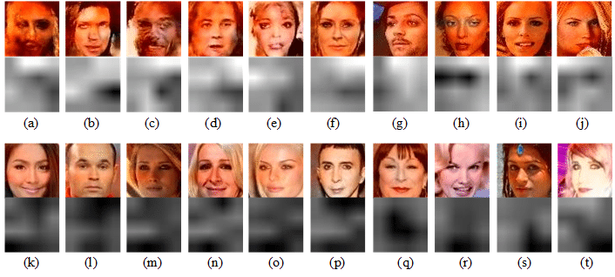
Implementation of Phase I
Deep Fake Images Detection:

Slide 8
Conclusion
In conclusion, the development of a deep fake detection system for images using machine learning represents a significant advancement in combating the proliferation of manipulated visuals and safeguarding the integrity of digital content. Through the extraction of diverse datasets, meticulous model training, and rigorous evaluation, researchers have made strides in creating robust and reliable detection mechanisms capable of discerning subtle inconsistencies between authentic and manipulated images. Moreover, the user experience design plays a pivotal role in ensuring intuitive interaction, user understanding, and trust in the system's capabilities, ultimately empowering users to identify and mitigate the impact of deep fake manipulation effectively.

Slide 9
References
[1] Deepfakes github. https://github.com/
deepfakes/faceswap. Accessed: 2018-10-29. 1,
2, 4, 14
[2] Faceswap. https://github.com/
MarekKowalski/FaceSwap/. Accessed: 2018-10-29.
1, 2
[3] Fakeapp. https://www.fakeapp.com/. Accessed:
2018-09-01. 4
[4] Sami Abu-El-Haija, Nisarg Kothari, Joonseok Lee, Paul
Natsev, George Toderici, Balakrishnan Varadarajan, and

Slide 10
References
Sudheendra Vijayanarasimhan. YouTube-8m: A large-
scale video classification benchmark. arXiv preprint
arXiv:1609.08675, 2016. 12
[5] Darius Afchar, Vincent Nozick, Junichi Yamagishi, and Isao
Echizen. Mesonet: a compact facial video forgery detection
network. arXiv preprint arXiv:1809.00888, 2018.
[6] Irene Amerini, Lamberto Ballan, Roberto Caldelli, Alberto
Del Bimbo, and Giuseppe Serra. A SIFT-based forensic
method for copy-move attack detection and transformation
recovery. IEEE Transactions on Information Forensics and

Slide 11
References
9.Chen, Chien-Wen & Chen, Wen-Zheng & Peng, Jain-Wei & Cheng, Bo-Xun & Pan, Tse-Yu & Kuo, Hsu-Chan. (2017). A Real-Time Markerless Augmented Reality Framework Based on SLAM Technique. 127-132. 10.1109/ISPAN-FCST-ISCC.2017.87.
10.Y Kaneto and T. Komuro, "Space-sharing AR interaction on multiple mobile devices with a depth camera," 2016 IEEE Virtual Reality (VR), Greenville, SC, USA, 2016, pp. 197-198, doi: 10.1109/VR.2016.7504721.
11.Xiao, Cheng & Lifeng, Zhang. (2014). Implementation of mobile augmented reality based on Vuforia and Rawajali. Proceedings of the IEEE International Conference on Software Engineering and Service Sciences, ICSESS. 912-915. 10.1109/ICSESS.2014.6933713.
12.Gabajová, Gabriela & Krajčovič, Martin & Matys, Marián & Furmannová, Beáta & Burganova, Natalia. (2021). DESIGNING VIRTUAL WORKPLACE USING UNITY 3D GAME ENGINE. Acta Tecnología. 7. 35-39. 10.22306/atec.v7i1.101.

Slide 12
Paper Publication Status (Phase-I )
TITLE | : | Immersive Interactive Technology and Enhancing Virtual Shopping using Augmented Reality.
AUTHOR | : | Vindodhkumar S, Kumar P, Raghavendran CS, Rithika S
PUBLICATION | : | Patent
STATUS | : | Filed

Slide 13
Paper Publication Status (Phase-II )
TITLE | : | Evolved Retail:Harnessing Markerless AR to Enhance Virtual Shopping Experience
AUTHOR | : | Vindodhkumar S, Kumar P, Raghavendran CS, Rithika S
CONFERENCE NAME | : | IEEE International Conference on Advances in Information Technology(ICAIT-2024).
PUBLICATION | : | Online
STATUS | : | Accepted

Slide 14
Thank You

